Slide 1
Energy Outlook in the 118th Congress

Slide 2
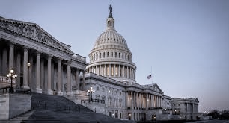
Introduction to The 118th Congress

Slide 3
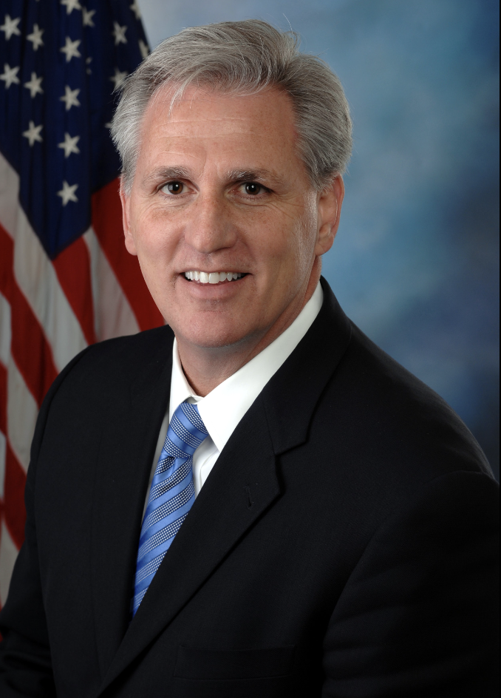
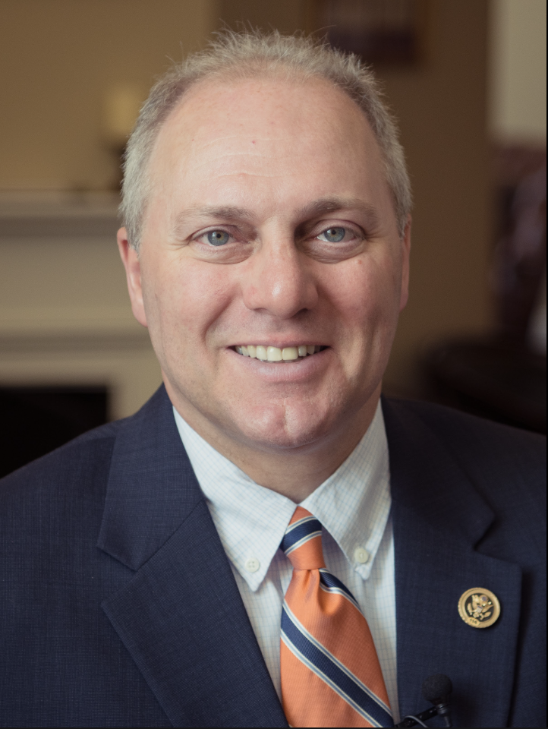
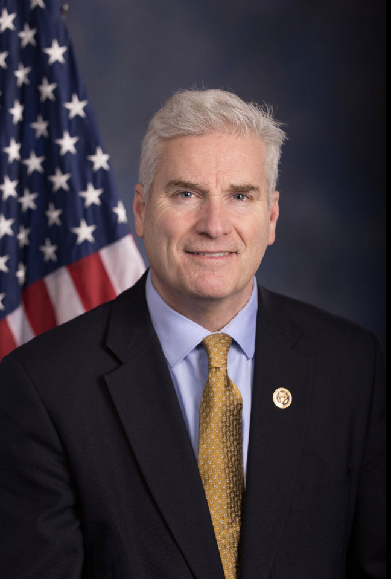
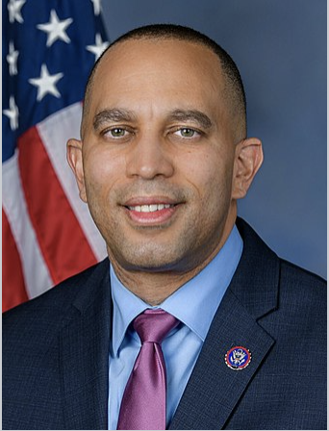
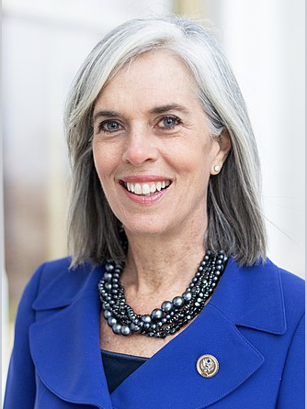
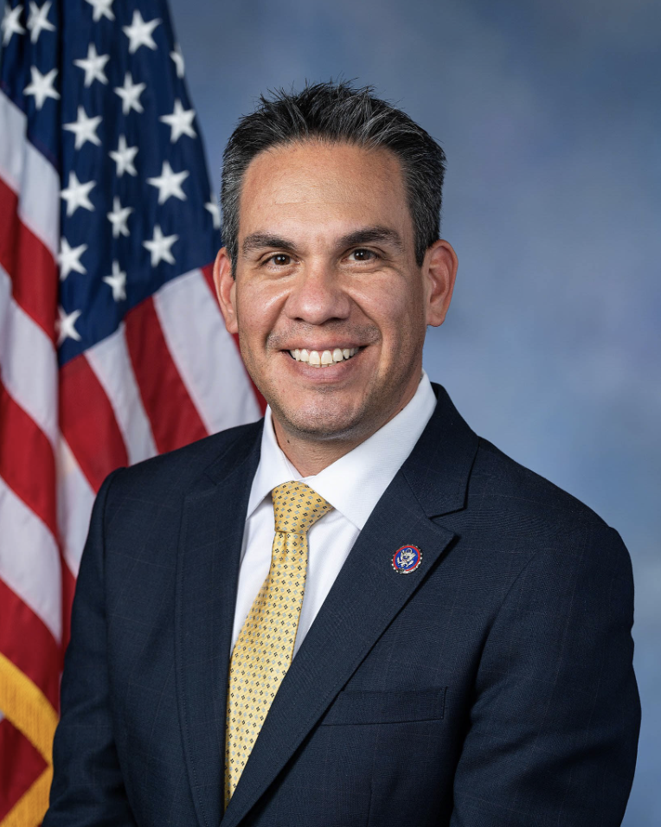
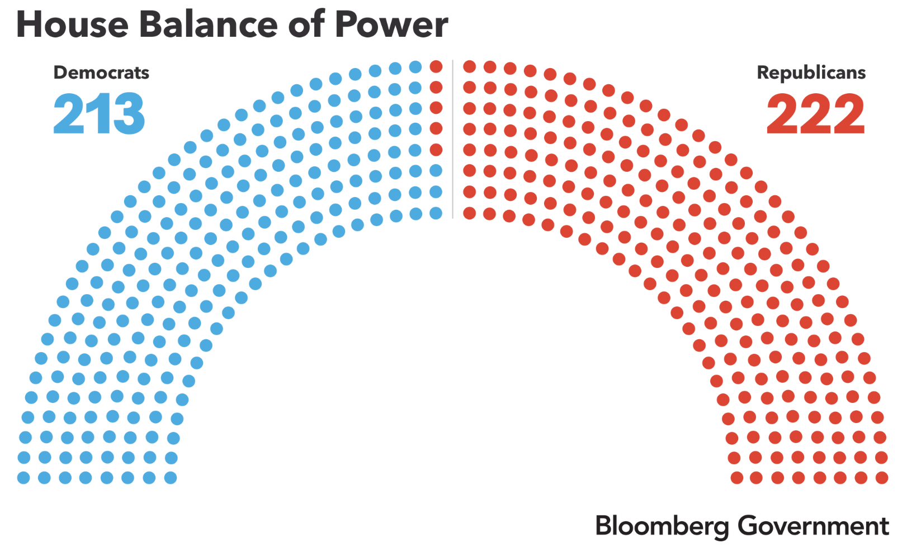
VA-4 congressional seat is vacant after the passing of Rep. Donald McEachin who won his reelection for the 118th Congress (special election will be held on February 23).
In order to win the Speakership, Kevin McCarthy made many concessions that weakened the power of the Speaker. It ultimately took 15 rounds of voting to elect him.
Newly-elected Rep. George Santos is under investigation after fabricating his bio during his campaign.
U.S. House of Representatives
Kevin McCarthy
Speaker of the House
Steve Scalise
House Majority Leader
Tom Emmer
Majority Whip
Hakeem Jeffries
House Minority Leader
Katherine Clark
House Minority Whip
Pete Aguilar
Democratic Caucus Chair
Notes:
Make up of the House
222 Rs vs. 212 Ds, demographics
1 vacant seat, remaining election for VA-4 (February 23)
House Leadership
Likely Speaker: Kevin McCarthy – he lost 30 members in caucus vote so he has been working to secure 218 for January 3rd speaker election. other possible speakers: Andy Biggs, Steve Scalise
Concessions for speakership: Motion to Vacate, Biden-specific select committee
Scalise spoke at white nationalist convention in 2002; reportedly said he was David Duke without the baggage; was shot at practice for Congressional baseball game in 2017
Critical committee changes
E&C
R - Cathy McMorris Rodgers (eastern WA), chair
D - Frank Pallone (NJ), ranking member
W&M
R - Brady retiring. 3-way race for chair: Vern Buchanan (FL), the next in line; Adrian Smith (NE), behind Buchanan in the seniority line; and Jason Smith (MO) - 4 spots down but looking to make a move.
D - Richard Neal (Boston), ranking member
Oversight
R - James Comer (KY), likely chair
D - Eleanor Holmes Norton (DC) and Stephen Lynch (MA) are most senior. Several other Ds in the running, including Gerry Connolly (VA) (who previously ran for Chair and lost to Maloney) and Jamie Raskin (MD)
Appropriations
R - Kay Granger (TX), likely chair
D - Rosa DeLauro (CA), likely ranking member

Slide 4
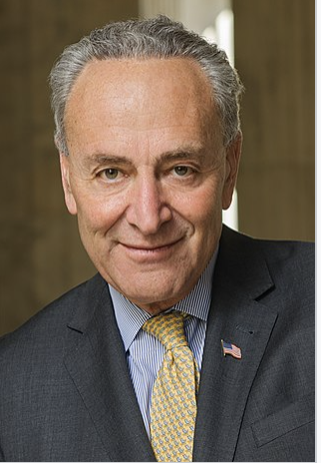
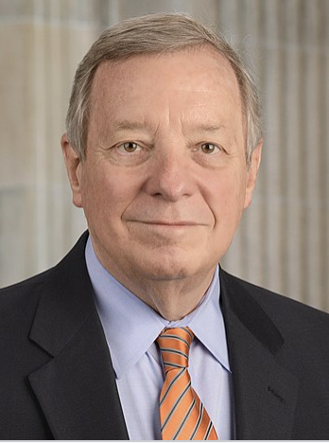
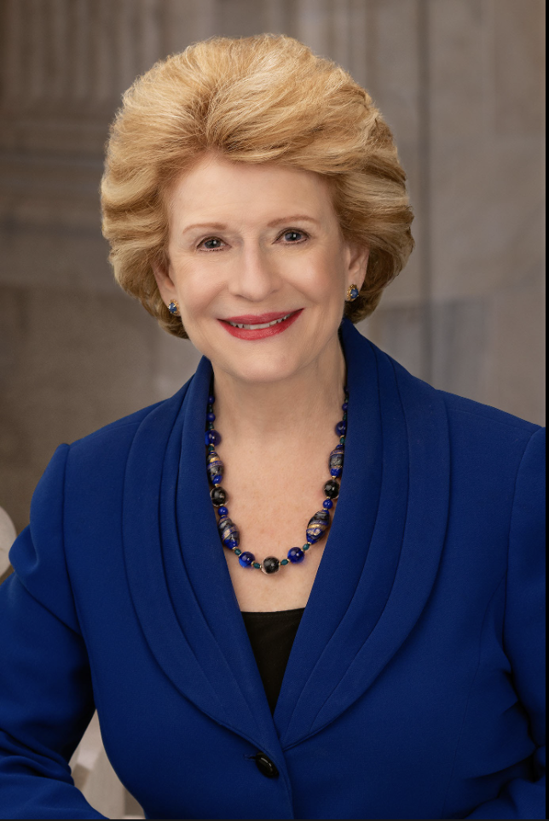
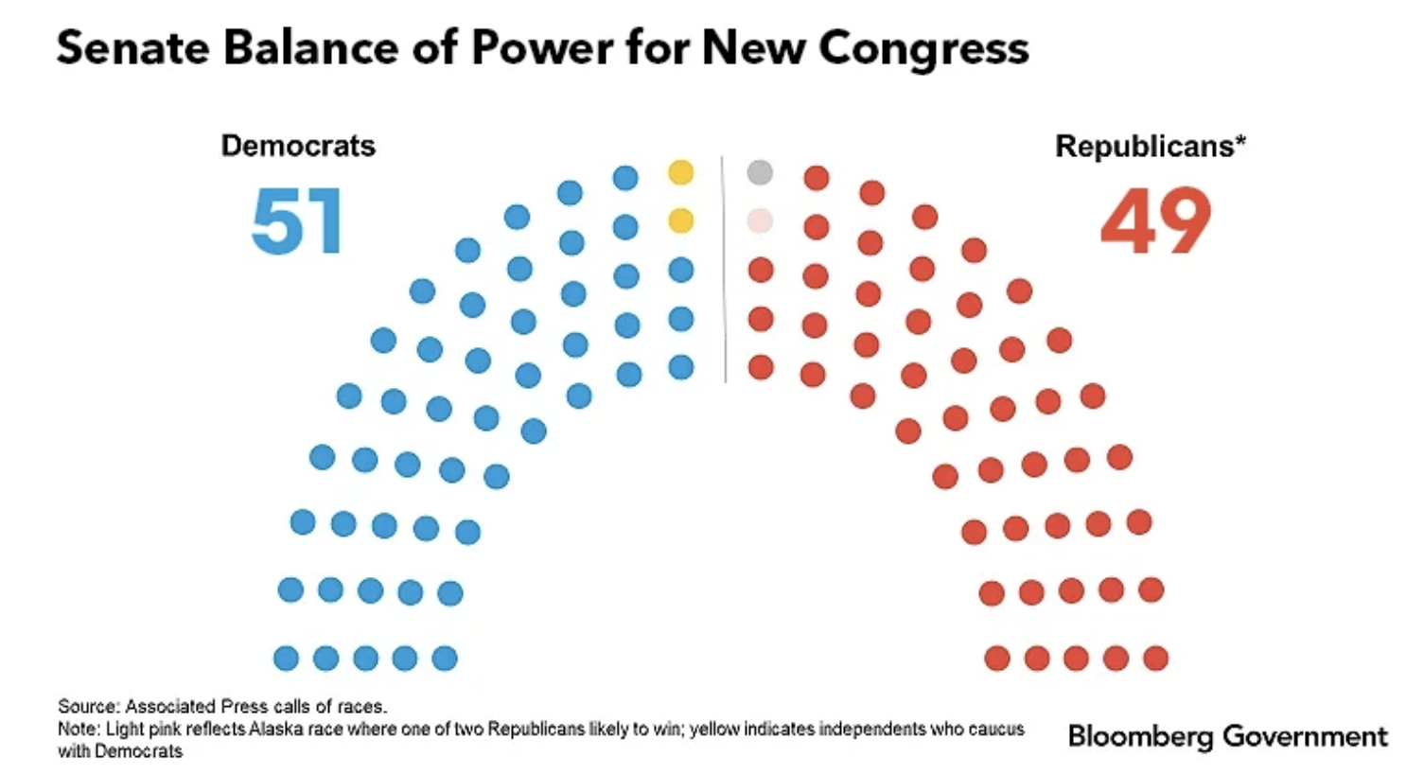
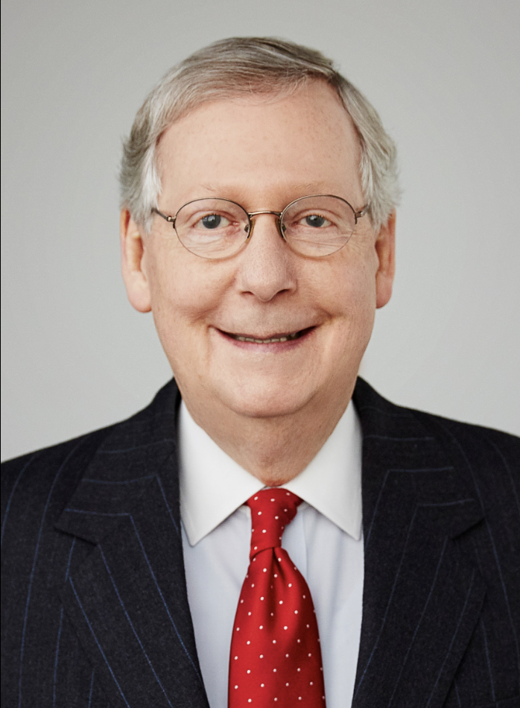
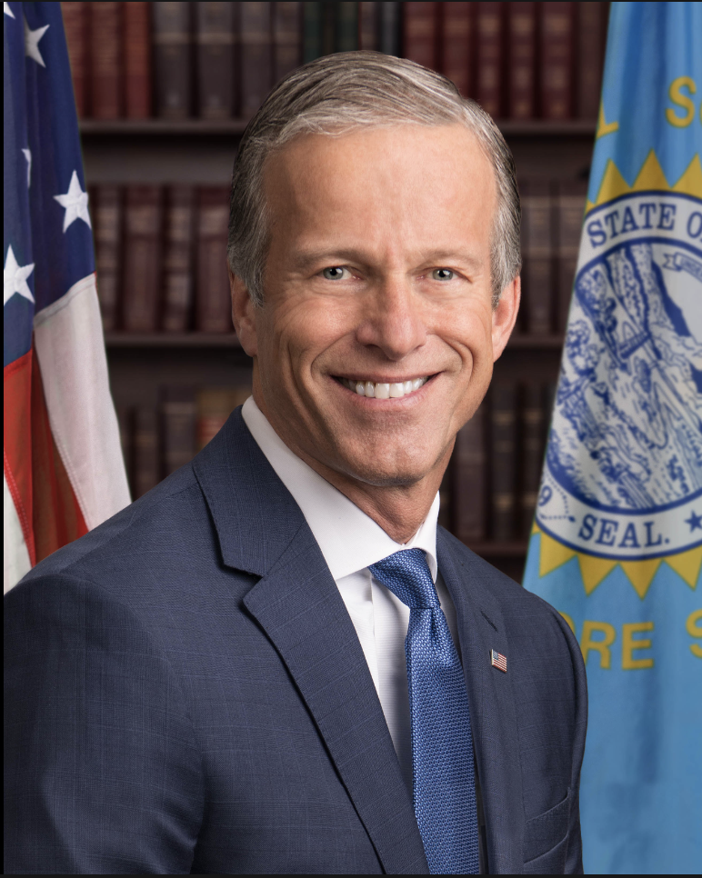
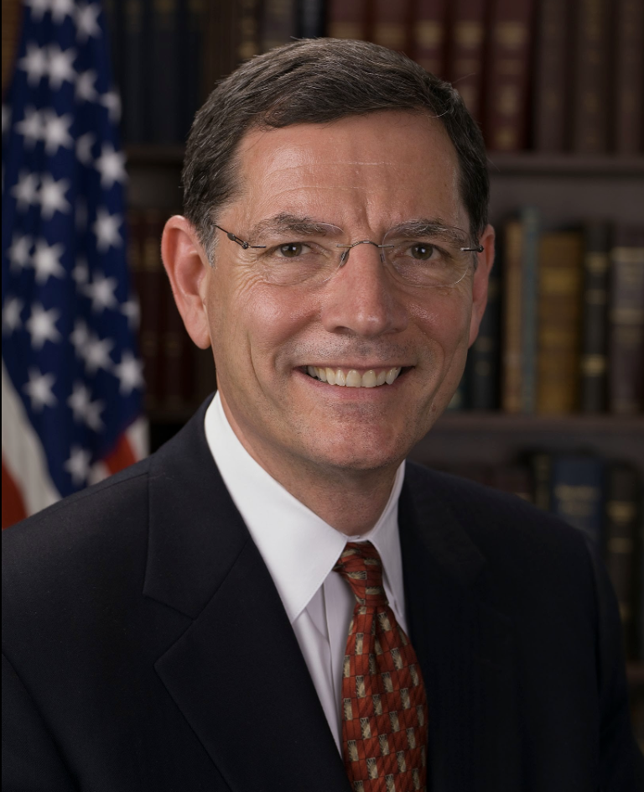
Patty Murray will take over as Senate president pro tempore, putting her third in line to the presidency.
Beginning January 8, the Senate will have 1 vacant seat after Sen. Ben Sasse resigns. The position will be filled by appointment by the governor.
At the end of the 117th Congress, Sen. Kyrsten Sinema switched to Independent, but she will continue to caucus with Democrats.
U.S. Senate
Chuck Schumer
Democratic Leader
Dick Durbin
Democratic Whip
Debbie Stabenow
Democratic Policy and Communications Committee Chair
Mitch McConnell
Republican Leader
John Thune
Republican Whip
John Barrasso
Conference Chair
Notes:
Make up of the Senate
49 Rs vs. 51 Ds, demographics
Newly independent member (Sinema)
1 vacant seat beginning Jan 8 (Ben Sasse) – The person appointed by the governor would serve until Jan. 2025 and an election would be held in 2024 to fill the seat for the remaining two years of the term
Gov. Pete Ricketts will seek the appointment
Senate Leadership
The biggest change made to the Senate Democratic leadership structure is that Sen. Patty Murray (D-Wash.) will take over as Senate president pro tempore, putting her third in line to the presidency
Critical committee
Energy and Natural Resources
D – Manchin (WV). chair
R – Barrasso (WY), ranking member
Finance
D – Wyden (OR), chair
R – Risch (ID), ranking member
EPW
D – Carper (DE), chair
R – Capito (WV), ranking member
Appropriations
D – Murray (WA), chair
R – Collins (ME), ranking member

Slide 5
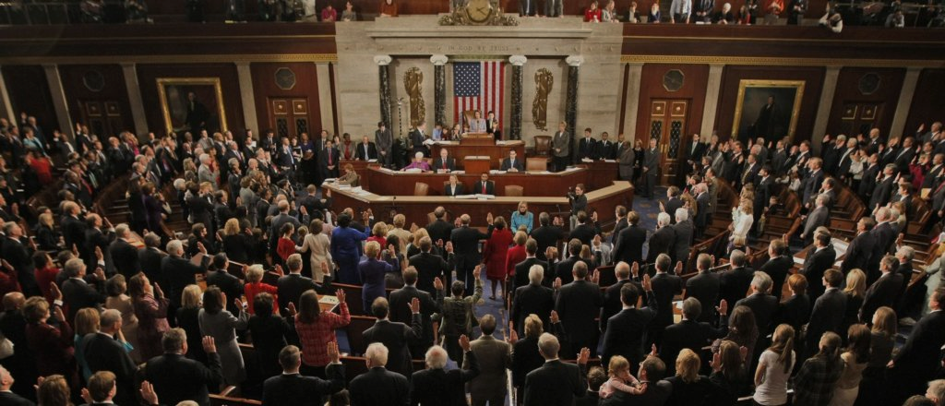
The Political Landscape

Slide 6
Major Themes
Republicans: Managing intra-party political divisions between moderate and MAGA factions
Democrats: Protecting IRA and IIJA, fighting pressure to cut spending, highlighting victories, and fighting Trump
End of the Power Sharing Agreement in the Senate: With Warnock winning GA, Democrats get a majority of committee seats, which will make advancing nominations and bills out of committee easier; also gives Dems greater subpoena authority.
Debt Limit and Government Funding
2024 Presidential Campaign
Wildcards: Speaker McCarthy’s power; Possible charges against Trump; Energy prices and inflation; War in Ukraine continues
Notes:
Subpoenas – Dems can subpoena witnesses with a majority vote in committee if the ranking member refuses to go along with the request; under previous 50-50 split, that was unlikely to ever happen. Dems have discussed using authority to go after bad actors in corporate America – profiteering, price gouging, etc.

Slide 7
Senate Democrats
House Republicans
Bipartisan Base Hits and messaging bills
“Must Do” bills
Government funding and debt limit
Farm Bill (2023)
FAA Reauthorizations (2023)
Tax Extenders - potential to extend Child Tax Credit
Confirm Judges and Exec Branch Nominations
“Commitment to America” Agenda
Energy legislation as early as January
Oversight of IRA, IIJA, regulatory actions (EPA, IRS, SEC) and Administration Officials (IRS, CFPB, FTC, few are safe)
Investigations: Secretary Mayorkas/Southern Border and Hunter Biden. Who else?
Election and voting legislation to fuel distrust and support Trump agenda
Notes:
Could be its own slide on shared governance – increasing the debt limit and funding the government will be THE big show of 2023. Breaching of the debt limit or government shutdown are both on the table; too early to give percentage chance of happening.
Very likely that many other Biden Administration officials receive oversight scrutiny – Likely IRS Commissioner Danny Werfel; CFPB Director Rohit Chopra; FTC Chair Lina Khan;
on FAA Reauth: With the current Federal Aviation Administration (FAA) authorization set to end on September 30, 2023, the FAA reauthorization process will begin in the 118th Congress. There is a shared consensus that a cost framework is needed for FAA to accommodate new entrants (drones, commercial space interests).

Slide 8
House Republican Energy Agenda (in their own words)
Fight Inflation and Lower the Cost of Living
Curb wasteful government spending that is raising the price of groceries, gas, cars, and housing, and growing our national debt
Increase take-home pay, create good-paying jobs, and bring stability to the economy through pro-growth tax and deregulatory policies
Make America Energy Independent and Reduce Gas Prices
Maximize production of reliable, American-made energy and cut the permitting process time in half to reduce reliance on foreign countries, prevent rolling blackouts, and lower the cost of gas and utilities
Ready-to-pass legislation
H.R. __ - Strategic Production Response Act: This bill prohibits non-emergency drawdowns of the Strategic Petroleum Reserve without a plan to increase energy production on federal lands
H.R. __ - Protecting America’s Strategic Petroleum Reserve from China Act: This bill prohibits the Secretary of Energy from sending petroleum products from the Strategic Petroleum Reserve to China
Notes:
Could be its own slide on shared governance – increasing the debt limit and funding the government will be THE big show of 2023. Breaching of the debt limit or government shutdown are both on the table; too early to give percentage chance of happening.
Very likely that many other Biden Administration officials receive oversight scrutiny – Likely IRS Commissioner Danny Werfel; CFPB Director Rohit Chopra; FTC Chair Lina Khan;
on FAA Reauth: With the current Federal Aviation Administration (FAA) authorization set to end on September 30, 2023, the FAA reauthorization process will begin in the 118th Congress. There is a shared consensus that a cost framework is needed for FAA to accommodate new entrants (drones, commercial space interests).

Slide 9
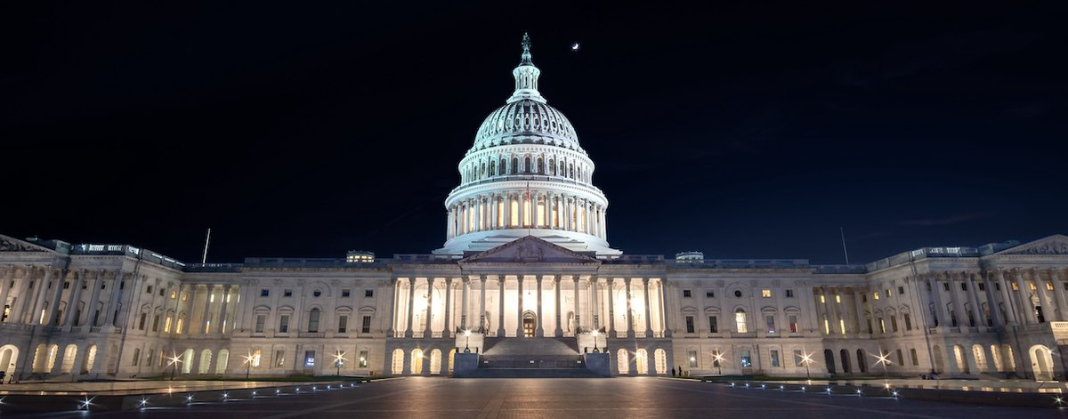
Looking Ahead

Slide 10
Hot Climate Topics of 2023
Inflation Reduction Act: Although the Inflation Reduction Act is not mentioned in the House Republican agenda, the climate law will come under significant scrutiny as House GOP search for the next Solyndra.
Permitting Reform: Failing twice to pass permitting reform last Congress does not mean the end of the permitting reform debate. Republicans are trying to push their own permitting reform, and some Democrats are open to reform seeing a need to streamline the process.
War in Ukraine: The war significantly disrupted energy markets around the world. In the U.S., it led to President Biden selling oil from the Strategic Petroleum Reserve and drove up the prices of gasoline and natural gas.
Public lands: Republicans will look to expand access to federal lands for oil and gas production, while Democrats will defend protected public lands over the next two years. Compromises may be sought with respect to permitting reform.

Slide 11
FERC
FERC Leadership and Makeup in Flux:
Manchin refused to advance Chairman Glick’s Renomination
Biden named Commissioner Willie Phillips Acting Chair
5th Democratic seat is vacant, awaiting a Biden nominee
Major Issues Awaiting FERC Action
Transmission planning and cost allocation NOPR
Interconnect NOPR
Order 2222 implementation - Accepted CAISO, NYISO, reviewing ISO-NE, MISO, PJM, SPP
Eliminate Order 719 opt out for Demand Response aggregations and align with Order 2222 (aggregations)

Slide 12
IRA Tax Credits
Credit/Provision | Description | Status
ITC/PTC requirements | - Prevailing wage requirements - Apprenticeship requirements only applies to projects > 1 MW (AC) | Initial guidance issued 11/30
Credit Enhancers | - Low income solar (10-20%) (48e) - Domestic Content (10%) - Energy Communities (10%) | - Low income - expected mid-February - Q1 for initial guidance for other adders
Monetization | - Direct Pay - Transferability | - Comment period closed. Q1 for initial guidance
Electric Vehicles | - New vehicles (30D) - Used vehicles (25E) - Commercial/fleets (45W) - Charging (30C) | - Initial guidance and FAQs issued on new, used and commercial vehicles - Comment period closed for 30C, awaiting guidance

Slide 13
Microgrids Tax Credit
The IRA extended the the Investment Tax Credit for energy property as well as expanded the credit to include microgrid controllers
The Credit: Base credit is 6%
Credit is increased by 5 times for projects meeting prevailing wage and registered apprenticeship requirements
+ Up to 10 percentage points for projects meeting certain domestic content requirements for steel, iron, and manufactured products
+ Up to 10 percentage points if located in an energy community
ITC Eligibility: In order to access the IRA ITC, microgrid controllers must meet the following requirements:
Generation capacity must be between 4 kilowatts (kW) and 20 megawatts (MW)
Capable of operating in connection with the electrical grid and as a single controllable entity
Capable of operating independently and disconnected from the grid
Cannot be part of the bulk power system
Began construction before January 1, 2025

Slide 14
ESG and Climate Disclosures
Conservative politicians and ideological groups are conducting an extremely well-funded and coordinated campaign against ESG investing, or what they label as “woke capitalism”
The attacks are particularly focused on:
State treasuries considering ESG metrics or investing in funds run by asset managers who consider any ESG metrics in their portfolios
Federal rules related to minimizing climate risk in investments
Upcoming Rule: The SEC will be releasing its Climate-Related Disclosure Rule, starting filing year 2024 for large companies (expected April 2023)
Congressional Engagement:
The upcoming rule has already experienced significant pushback from members of Congress suggesting that it is an overreach of the SEC’s authority and introducing federal funding riders to prohibit the implementation and enforcement of the rule
New Chairman of the House Financial Services Committee, Rep. Patrick McHenry, has already announced the committee will focus its oversight efforts on the SEC’s climate disclosure rule

Slide 15
Climate Finance
IRA & IIJA funds now moving to implementation phase
Agencies such as DOE, EPA, and USDA standing up programs, issuing RFIs, FOAs, etc. – a good time to provide input!
Grants and other opportunities posted on sam.gov and grants.gov
EPA GHG Reduction Fund (“green bank”) - $27 billion for communities & projects
Public comment period ended 12/5/22; Acting Director Jahi Wise announced in Dec.
Waiting on EPA to announce next steps - must begin implementation by 2/15/23
DOE LPO
Only about $119 billion in loans requested so far; exposure hovering around only $18 billion (of $367 billion in authority thanks to IRA), only about 10% of applications active – plenty of room to apply and access financing
Other financing agencies have significant financing authority & are eager to support climate-related projects – EXIM, DFC, USTDA (combined ~$195 billion in authority) – can apply anytime

