Slide 1

The EU Reaction to the IRA
Politics, Policy and Prognosis
19 January 2023
Notes:
Detailed layout instructions and tips to follow

Slide 2
Today’s presentation
Initial EU Reactions to the IRA
Main EU concerns
EU Member States Responses
EU-US Relations
President Von der Leyen’s Next Act
Measuring Competitive Sustainability

Slide 3

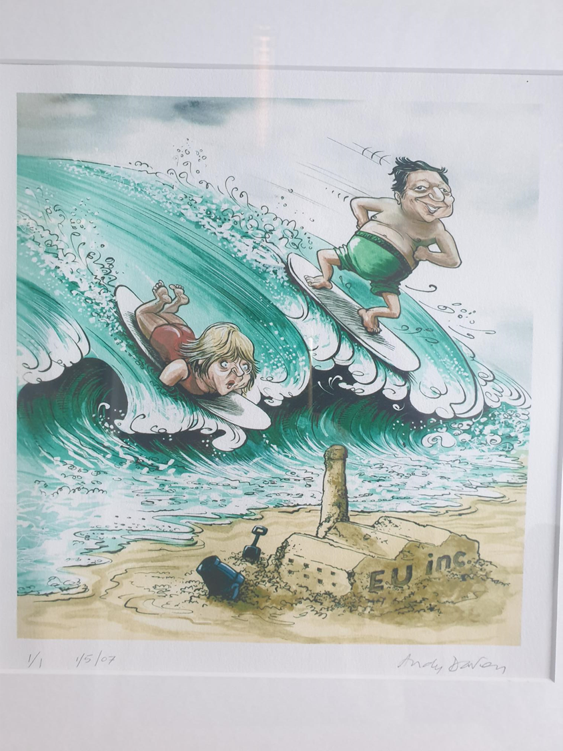
Initial EU Reactions to the IRA
From ‘Wow!?’ to ‘Uh Oh!?’
Notes:
EU was taken off guard by the development, not expected, few details already anticipated, analysed
Cautiously positive about the extent of ambition and change of policy in context of COP negotiations – struggled to wholeheartedly welcome the development
Unsure as to whether it really had sufficient bipartisan support, and may not be implemented in practice
And then growing awareness that the scale and speed of available financing would impact not just investment in US clean tech investment. Image from 2007 where the Green Wave was from EU policy (Merkel and Barroso) but the image might now work if we think of the wave as a transatlantic one…
Specific worries from some sectors in particular – EV and batteries – and some countries, including crucially both France and Germany, which has changed the dynamic of the EU debate.

Slide 4
Main EU concerns:
losing investment and leadership in clean tech race to the top
The IRA can change the investment landscape for green subsidies, particularly concerning renewable energy, batteries and EVs
  European companies tempted to look into how they could benefit from it by creating or expanding their operations in the US
Compared to certain EU and national policies (such as the REPowerEU, RES subsidies) the IRA can provide long term investment and policy clarity and the lack of spending or production caps linked to the subsidies, which could redirect investment from Europe to the US.
  EU risks up to E8bn in investment shifting to the US from the EU - according to French estimates
Main concern in the EU is the domestic content requirements for the clean energy and electric vehicle subsidies which might be higher than initially indicated.
  US reaffirmed that EU companies can benefit from the Commercial Clean Vehicle Credit scheme however concerns remain about EU clean vehicle producers under the Clean Vehicle Credits.
Backdrop and conflated competitiveness concern for some energy-intensive industries
  longstanding as well as immediate industrial fossil energy price disadvantage with the US and continuing frustrations with Chinese state support for key industries being unfair

Slide 5
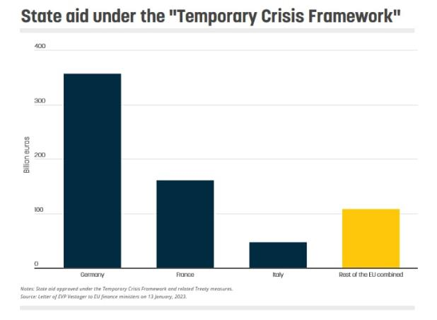
EU Member States Responses:
Interventionists gaining over liberal marketeers?
France and Germany are most vocal and published a common paper calling for an EU industry policy, national measures for domestic industry support and EU waiver on IRA. They say the EU needs to match US green industry subsidies and France recently announced a green industry bill that echoes the German idea of an EU IRA. New Joint paper expected to be released on 22 January.
France is pushing for a ‘Buy European’ act, or “Made in Europe” strategy – closely mirrors new Commission proposals (see later).
Germany is against the idea of a new EU funding scheme (Scholz saying EU Recovery Funds can still be redirected), but it is softening its stance on France’s ‘Buy European’ plans and Habeck has proposed setting "local content" requirements.
Spain, Belgium, Italy and Slovenia have all expressed support for additional EU measures on state aid rules, funding and trade measures.
BUT
Sweden – less outspoken but as current President of the Council of Ministers, wary of risks to Single Market, unfair treatment of smaller Member States, and a drift towards protectionism.
Denmark, Finland, Ireland, the Netherlands, Poland and Sweden ‘Non-Paper’ on State Aid Crisis Framework makes similar points

Slide 6
EU-US Relations:
from tensions and strains to intense co-opetition?
Ongoing but diminishing risk of trade confrontation through mutual misunderstanding
  EU could take the US to the WTO
  EU could institute retaliatory tariffs but cooperation continues
High-level, high-profile engagement with the US Administration seeking
  The US re-opens the IRA to include EU producers through implementation process
  The US Treasury Department issues the EU a waiver
Gradual accommodation and common interest development
  US and EU strike an IRA-CBAM deal – but how much difference will it really make?
  Commonly agreed impact assessments on IRA impacts on EU investment and clean tech value chain development – NB the DIW assessment of 18 January suggests EU concerns ‘exaggerated’
  Better understanding of common global interests and challenges motivating the US IRA and the EU’s economic interests – Climate + Strategic Autonomy + ‘Western Democratic Values’
  EU responds with its own renewed industrial investment plan…as President Von der Leyen has now indicated in her speech at Davos on 17th and in the European Parliament on 18th January

Slide 7
President Von Der Leyen’s Davos Announcement
A Green Deal Industrial Plan for Competitive Sustainability
A ‘Net Zero Industry Act’
  Set industrial goals for 2030 for strategic projects along key supply chains for more rapid scale-up
  Faster permitting and access to IPCEI for more companies, including SMEs
  Critical Raw Materials Act – and ‘Club’ with ‘like-minded partners’
Clean Tech Investment and Finance
  State Aid review to speed up and simplify approvals of national measures (as being proposed by EVP Vestager)
  EU Sovereignty Fund plus interim ‘bridging solution’
Workforce Skills Development
  European Year of Skills priority
Trade Agreements and Defence
  ‘Working with the US to find solutions’ to the IRA, develop common standards, transatlantic marketplace
  Implement Agreements with Canada and UK, Conclude with Mexico, Chile, New Zealand, progress with India, Indonesia, re-start Mercosur
  China: ‘more robust defence’, ‘de-risk rather than decouple’, Use ‘Foreign Subsidies Regulation for ‘unfair practices’
Notes:
Four pillars, largely repackages what has already been indicated but with the addition of a NZIA that would add new targets and focus.
Reflects many of the ideas that the French have pushed – but if package to work, with need Soverignty Fund to operate and be inclusive of smaller countries interests
Ongoing reservations about the review of state aid in such a rapid process
Balancing act to ensure a more positive engagement with US is coupled with other international trade agreements and defensive measures, notably with stronger approach to China
Overall – suggests that a watershed moment has been reached where the global clean tech race to the top and opportunities from the transition are more important than sustaining ultimately unsustainable businesses. Competitive arguments have radically changes from a few years ago.

Slide 8
Competitive Sustainability Index: A First Impression
Economy / Productivity
Society / Fairness
Governance / Stability
Green / Environment
4 dimensions
27 countries
31 Components
84 Indicators
Endless possibilities for performance improvement
Notes:
New paradigm for assessing competitiveness for economies in transition, where productivity and GDP growth alone no longer determine longer term advantage. Transformation underway.
Commission’s own Competitive Sustainability strategy for the Semester already envisaged investment being retained and attracted by the economy due to ESG as well as core economic factors.
And even core economic factors need to reflect how purposeful (e.g. climate) innovation is at the core of an economies ability to successfully attract investment for the transition.
First CSI published at the end of last year shows the metrics are becoming available to do this – and that the EU has many strengths – as well as can do better in key areas of the economic transition – and hence greater focus, speed and scale from its measures, much as the VdL strategy implies – are key to the right response.

Slide 9
Martin.Porter@cisl.cam.ac.uk

